Slide 1


Slide 2
John 21:3-6
3 Simon Peter said to them, “I am going fishing.” They said, “And we are coming with you.” So they went out and got into the boat; and that night they caught nothing.

Slide 3
4 As morning was breaking, Jesus [came and] stood on the beach; however, the disciples did not know that it was Jesus. 5 So Jesus said to them, “Children, do you have any fish [to eat along with your bread]?” They answered, “No”.

Slide 4
6 And He said to them, “Cast the net on the right-hand side of the boat (starboard) and you will find some.” So they cast [the net], and then they were not able to haul it in because of the great catch of fish.

Slide 5
Jesus appeared to His disciples:
1st time (John 20:19)
evening of His resurrection
they were behind barred doors
Thomas was not with them (John 20:24)

Slide 6
Jesus appeared to His disciples:
2nd time (John 20:26)
8 days later
inside the house (behind barred doors)
Thomas was with them

Slide 7
Jesus appeared to His disciples:
3rd time – (John 21:1-3)
at the sea of Tiberias (Galilee)
they went fishing (Simon Peter, Thomas, Nathanael, James and John, two other disciples) but caught nothing

Slide 8
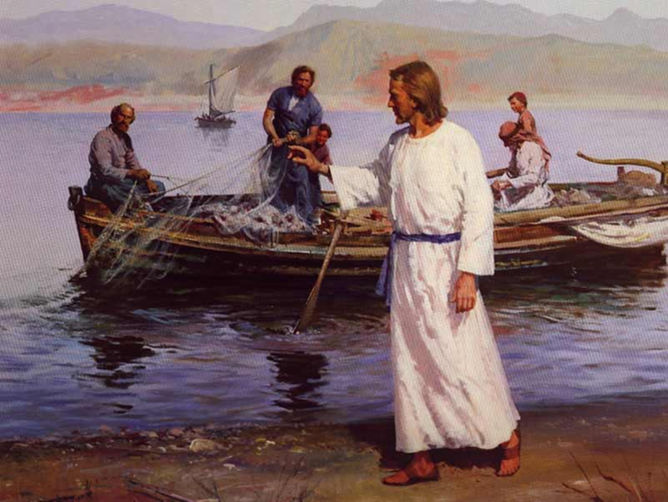
John 21:4-5 Jesus …
stood on the beach (v4)
said “Children, do you have any fish?” (v5)
Nobody recognize Him

Slide 9

Why can’t we NOT recognize Jesus?
Too focused on problem
Too distracted with what is going on
Too anxious with many things

Slide 10
Jesus said to them (John 21:6)
“Cast the net on the right-hand side of the boat and you will find some.”
Jesus instructed the fishermen

Slide 11
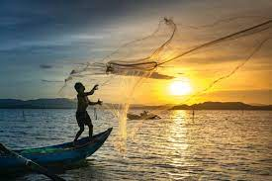
Normally, the net is cast to the left side of the boat so they could be hauled easily - led by the dominant right arm

Slide 12
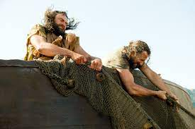
John 21:6b So they cast [the net], and then they were not able to haul it in because of the great catch of fish.

Slide 13
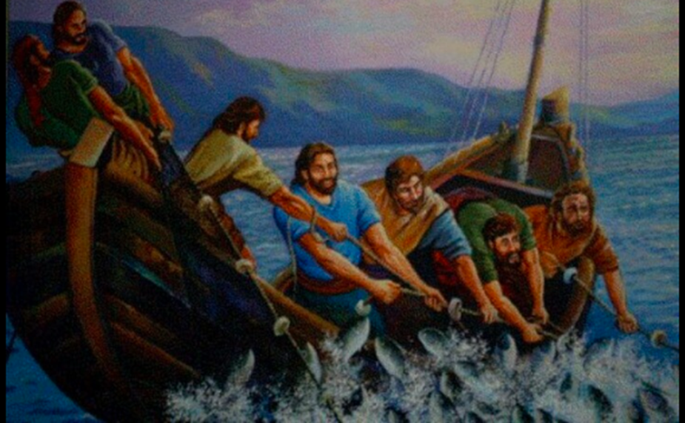
John 21:11
net was full of 153 large fishes
the net was not torn

Slide 14
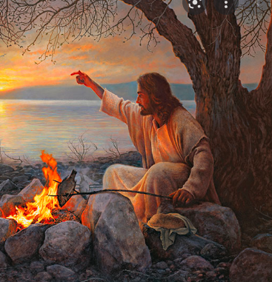
Bonus!!! Extra reward…
John 21:9 So when they got out on the beach, they saw a charcoal fire set up and fish on it cooking, and bread.

Slide 15
Proverbs 10:22
The blessing of the Lord brings [true] riches,
And He adds no sorrow to it [for it comes as a blessing from God].

Slide 16
As soon as they receive the reward of their obedience … they immediately recognize Jesus
John 21:7 Then that disciple (John) whom Jesus loved (esteemed) said to Peter, “It is the Lord!”

Slide 17


Slide 18

1. Listen to God’s instruction
Is this from the Lord?
Is this from my own?
How to make sure?
Backed up by God’s Word
You have peace

Slide 19

2. Choose to obey
Act right away
Delayed obedience is disobedience

Slide 20
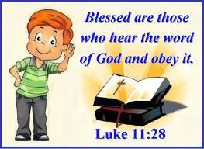
3. Receive the reward

Slide 21
Deuteronomy 5:33 (NIV)
Walk in obedience to all that the Lord your God has commanded you, so that you may live and prosper and prolong your days in the land that you will possess.

Slide 22
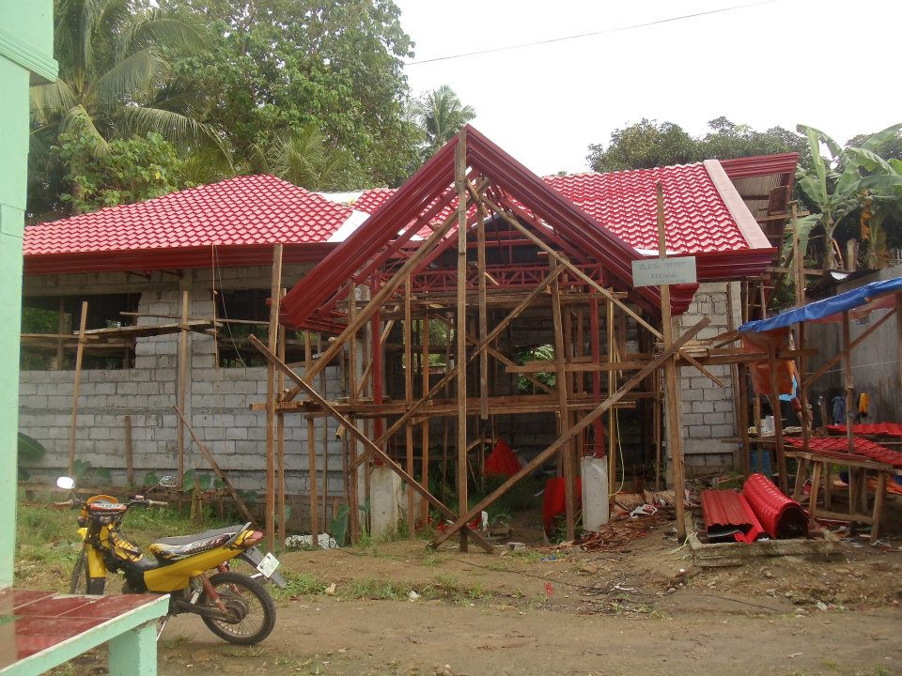
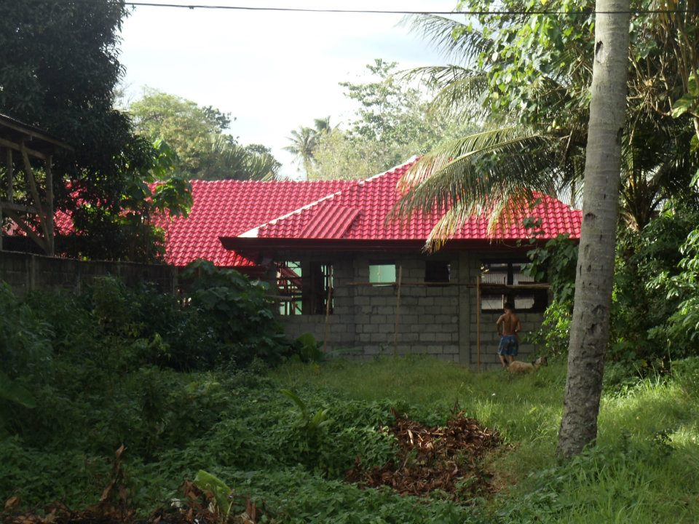

2010 - started building our house

Slide 23
We received this word in 2012
“Is it time for you yourselves to live in your [expensive] paneled houses while this house [of the Lord] lies in ruins?” - Haggai 1:4

Slide 24
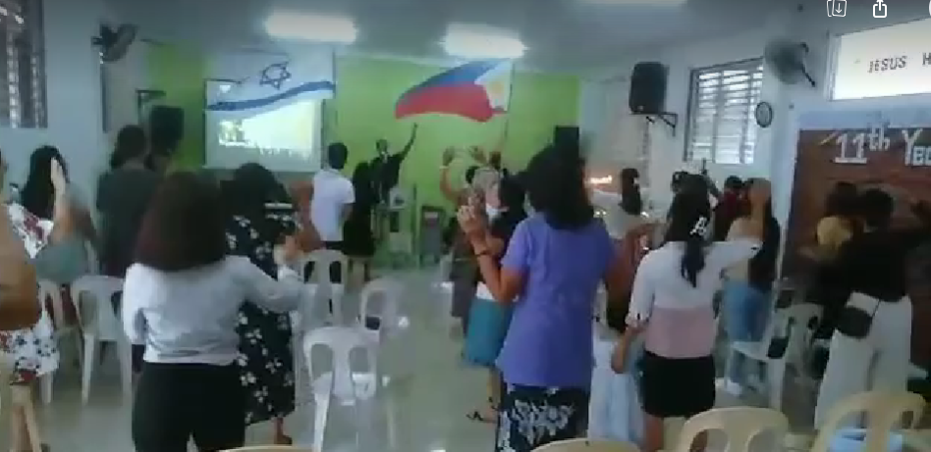
The previously planned house building was converted into a place of worship

Slide 25


December 2015: we acquired a house in a high-end subdivision

Slide 26
2010 – my husband was called by the Lord to a full-time ministry
I received my promotion in 2011

Slide 27
Ephesians 6:1-2
1 Children, obey your parents in the Lord [that is, accept their guidance and discipline as His representatives], for this is right [for obedience teaches wisdom and self-discipline]. 2 Honor [esteem, value as precious] your father and your mother [and be respectful to them]—this is the first commandment with a promise ---

Slide 28
Ephesians 6:3
3 so that it may be well with you, and that you may have a long life on the earth.

Slide 29


